Slide 1
Applied FHIR for Designers Q&A
Lloyd McKenzie
April 21, 2022

Slide 2


Questions?
http://chat.fhir.org lloyd.mckenzie@accenture.com

Slide 3
Learning Objectives
You should be able to:
Understand the different architectural approaches to using FHIR - and where to go to help decide the best approach for a given use-case (includes SMART, CDS Hooks, etc.)
Describe some of the considerations around persistence models when exposing a FHIR interface
Explain the technologies that FHIR provides to support terminology interoperability
Know the technologies that FHIR provides to document and define FHIR interfaces
Choose how best to leverage the FHIR community and maximize interoperability with existing solutions
Notes:
http://hl7.org/fhir/us/davinci-hrex/exchanging.html#decision-points

Slide 4
From wire to store
REST interface
JSON/XML
JSON/XML
JSON/XML
FHIR Parser
FHIR Parser
FHIR Parser
Fhir Service
POCO/POJO
POCO/POJO
POCO/POJO
O-R Map
Serialize
Serialize
Storage
NoSql (Xml/Json)
DBMS
DBMS
Notes:
Relational persistence includes trade-offs
What do you need to search on/analyze?
What can you treat as a blob

Slide 5
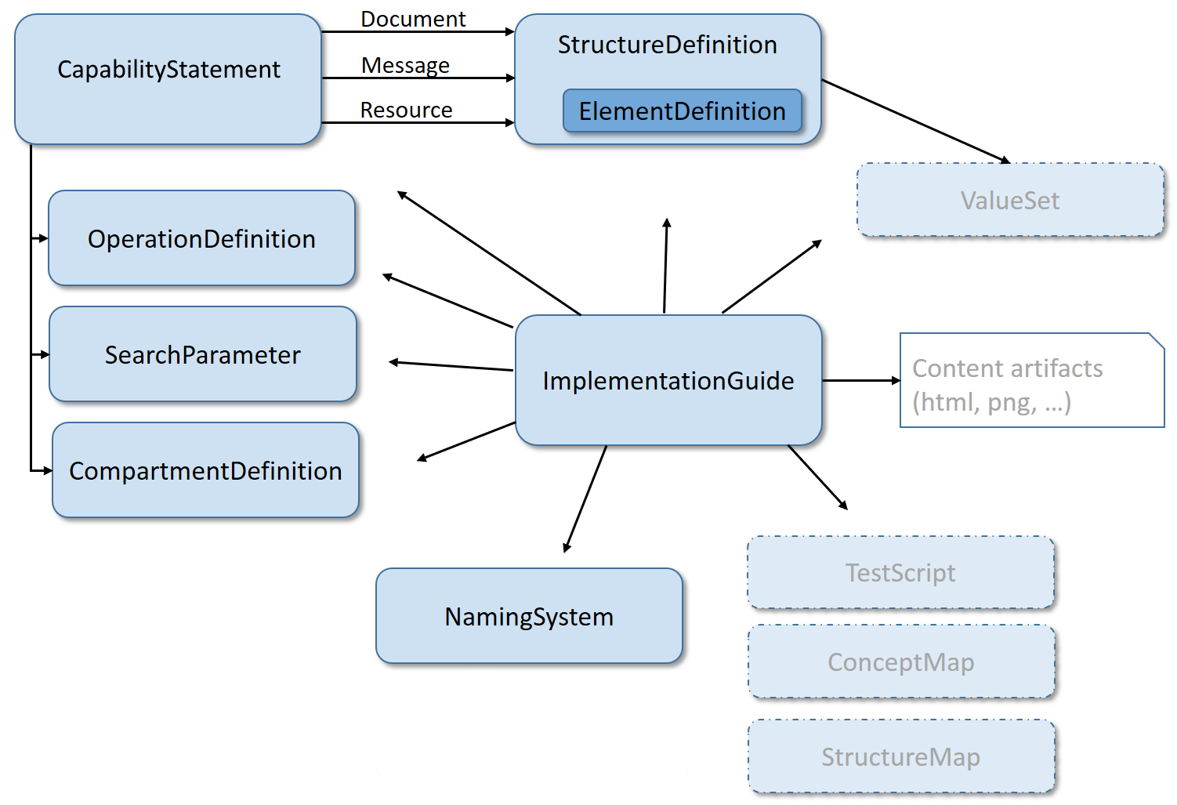

Slide 6
Bonus content

Slide 7
Combining paradigms
No requirement for a system to only support one paradigm
E.g. hospital may be primarily messaging, but use documents for discharge summaries and reports and expose registries and appointments via REST with a few custom services for decision support or specialized workflow
Data (generally) shared easily across paradigm boundaries

Slide 8
Caveats with combining paradigms
If updates come in via document, message or service, RESTful version id still needs to increment
Documents should typically be persisted whole, not reconstituted from parts
Ensures signature validity
Legacy messaging systems may not provide the metadata to easily expose or manipulate discrete resources via REST

Slide 9
Exchange options
v3
App
v2
FHIR
PHR
FHIR
Broker
Comm.
Interface
FHIR
DB

Slide 10
Repository model
HIS
LIMS
PACS
SystemX
Gateway
FHIR
FHIR
FHIR
FHIR
FHIR
Vendor Neutral Repository

Slide 11
Beyond Exchange
v3
Other
v3
v2
Other
v2
Decision Support
Broker
FHIR
FHIR
Repository
FHIR
X12

Slide 12
Variable Server capabilities
FHIR defines a number of mechanisms to give clients control of queries
Paging, many filters, _include, _summary, compartments
However, these are all optional . . .
What should a server do?
Cost/benefit trade-off
More you support, more clients will work with you
Some capabilities may be very expensive in some architectures
Do as much as you can, “within reason”

Slide 13
Variable Server capabilities (cont’d)
What should a client do?
Take advantage of desired capabilities, work with narrow set of servers
Works well in closed environments
Use minimal capabilities, work in most/all environments
Use advanced features where available, fallback to client processing where needed
More efficient but more complex client

Slide 14
Prohibiting data elements
In FHIR, you shouldn’t prohibit unknown extensions or unsupported data elements
You can set a maxOccurs=0 for data elements
This forces clients to customize what they send you – bad practice
Better to accept and ignore
In limited cases, may be liability issues with ignoring data, so rejecting is necessary

Slide 15
Interoperating with legacy
How do you make FHIR play nicely with v2, v3, CDA?
Not enough time to cover here
Look at
http://hl7.org/fhir/comparison.html
The mapping to v2 and CDA streams on http://chat.fhir.org

Slide 16

Estimating
How much will implementing a FHIR solution cost?
Considerations
Reference implementations help
Learning curve is lower
Still a curve if unfamiliar with XML / JSON / REST
Faster to “drive by” interoperability
Can’t speed consensus
Tools to help with mapping to internal codes and structures, still takes time
Anecdotal is “faster” to “significantly faster” to implement

Slide 17
Bundle decisions
Where’s the resource – bundled, contained, remote?
“contained” should only be used if resource can’t stand alone
Can’t exist if parent is removed
Not enough information to resolve
In bundle for document if part of narrative rendering rules or want part if signed content
In bundle for message if needed to process message and no separate query desired

Slide 18
Missing data
Extremely few resource or data type elements are required (minOccurs > 0)
Resources and data types are context independent
Extensions might supersede core elements
Therefore
Don’t assume data will be present
Always check for element/@value, not just element
May need to validate to a profile to enforce requirements

Slide 19
Looping
FHIR resources are interrelated in a network, not a hierarchy
Direct and indirect looping relationships are possible
In resource definitions & instances
Even if not possible with core elements, may occur with extensions
Parsing and processing algorithms must deal with this possibility

